Slide 1
15-618 Parallel Computer Architecture and Programming
Parallel Influence Maximization in Social Networks
Carnegie Mellon University
Zican Yang(zicany) Yuling Wu(yulingw)

Slide 2
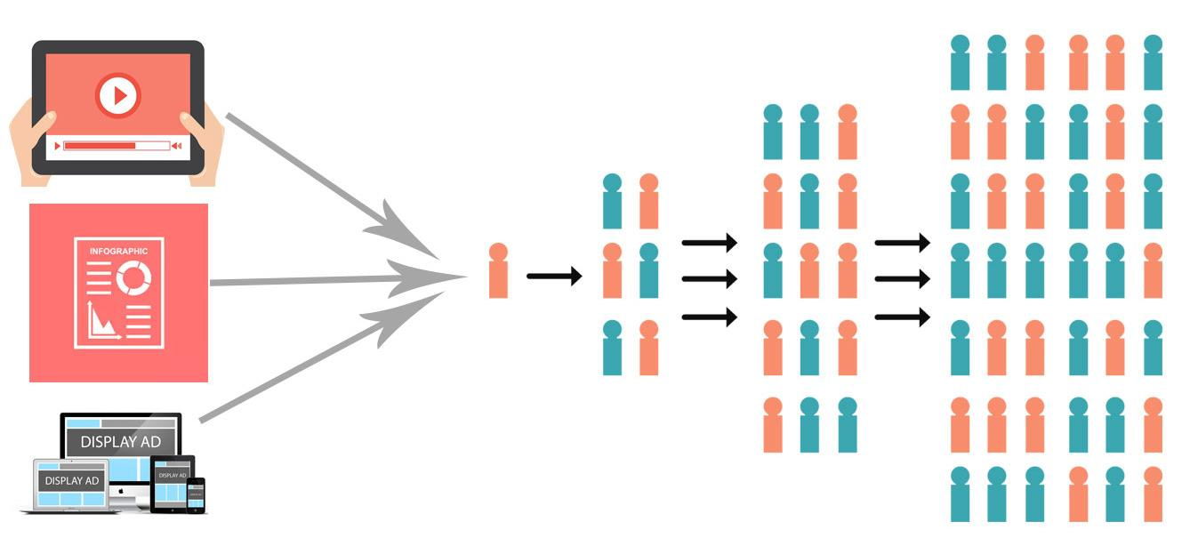
Background
Basic concepts:
People will choose to talk with their friends about one thing with some probabilities.
A person cannot accept the same information that he/she has already known.
Imagine that if you have an important message or an interesting AD, and you can only send it to K people. How would you select these K people to make it spread as widely as possible?
Figure Reference: https://www.gowebcenter.com/all-you-need-to-know-about-viral-marketing/

Slide 3
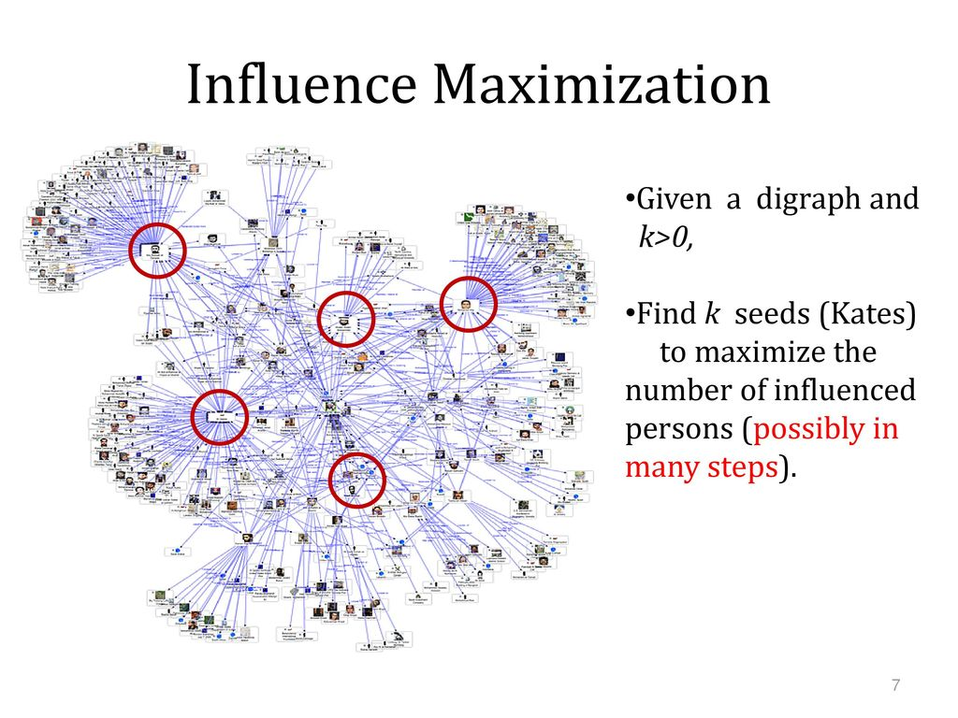
Background
Given an undirected graph G=(V,E) with propagation probability p for each edge, find k seed nodes which can activate maximum number of nodes. A node can only be visited once.
Our task is to parallelize it in different dimensions.

Slide 4
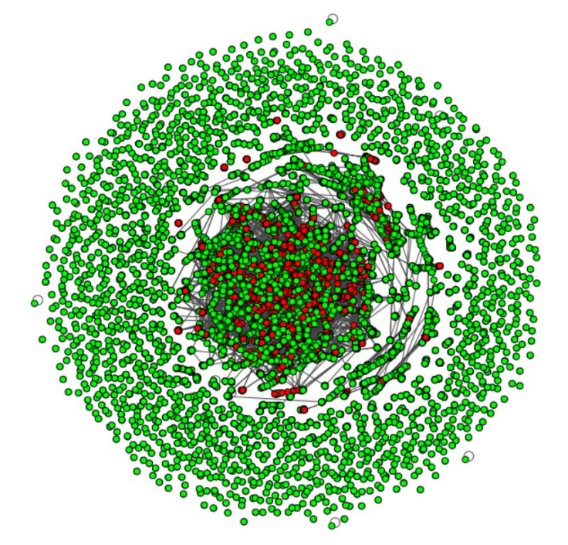
Background: Monte Carlo Simulation
To evaluate the quality of a seed node set, we use Monte Carlo simulation. We perform the propagation process with the seed node set on the graph for several times and take the average of their result.

Slide 5
Background: Greedy and Heuristic algorithms
There are 2 kinds of algorithms to solve the influence maximization problem, greedy and heuristic. Greedy algorithms can give the best seed node sets but run very slow. Heuristic algorithms run very fast but the seed node sets is not good as greedy.
Greedy
Run Monte Carlo simulation on all possible permutations of seed node sets and choose one with best result.
Heuristic
Sort nodes by some metrics and select top-k nodes, maybe with some optimization method (Degree-Discount) for better result.

Slide 6
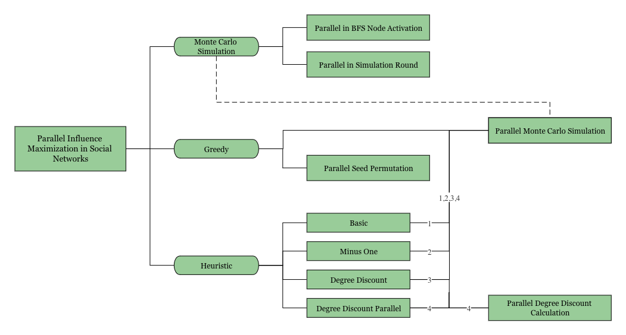
Approach

Slide 7
Approach: Parallel Monte Carlo Simulation
The pseudo code of Monte Carlo Simulation is as follows:
foreach (rounds) {
foreach (vertex) {
BFS(vertex)
}
}
We implemented two level of parallelism in Monte Carlo Simulation.
Parallelize each round’s computation. There are no dependencies.
Parallelize each vertex’s BFS computation in a single round. There are dependencies between vertices and we solved by locks.

Slide 8
Approach: Parallel Greedy Algorithm
The pseudo code of greedy algorithm is as follows:
foreach (possible permutation of seed nodes in all vertices) {
monteCarloSimulation()
}
Choose the permutation with best simulation result
We implemented two level of parallelism in greedy algorithm.
Parallelize each permutation’s computation. Because we have to choose the permutation with best simulation result, there are dependencies.
Parallelize Monte Carlo simulation in each permutation as previous shown.

Slide 9
Approach: Parallel Heuristic algorithms
We choose Degree-Discount heuristic for better result. The process of Degree-Discount heuristic is as follows:
Sort vertices in descending order by degree
Select node with greatest degree
Minus selected node’s neighbors’ degree by Degree-Discount formula
If all seed nodes has been selected, exit. Else, go to step2
The seed node selection process does not involve Monte Carlo simulation. We parallelize step 2 and step 3. If we have T threads, every time we select T nodes with highest degree and update their neighbors’ degree in parallel. There are dependencies when updating neighbors’ degree, and we solve this by locks. There is also a tradeoff between parallelism and quality of result.

Slide 10
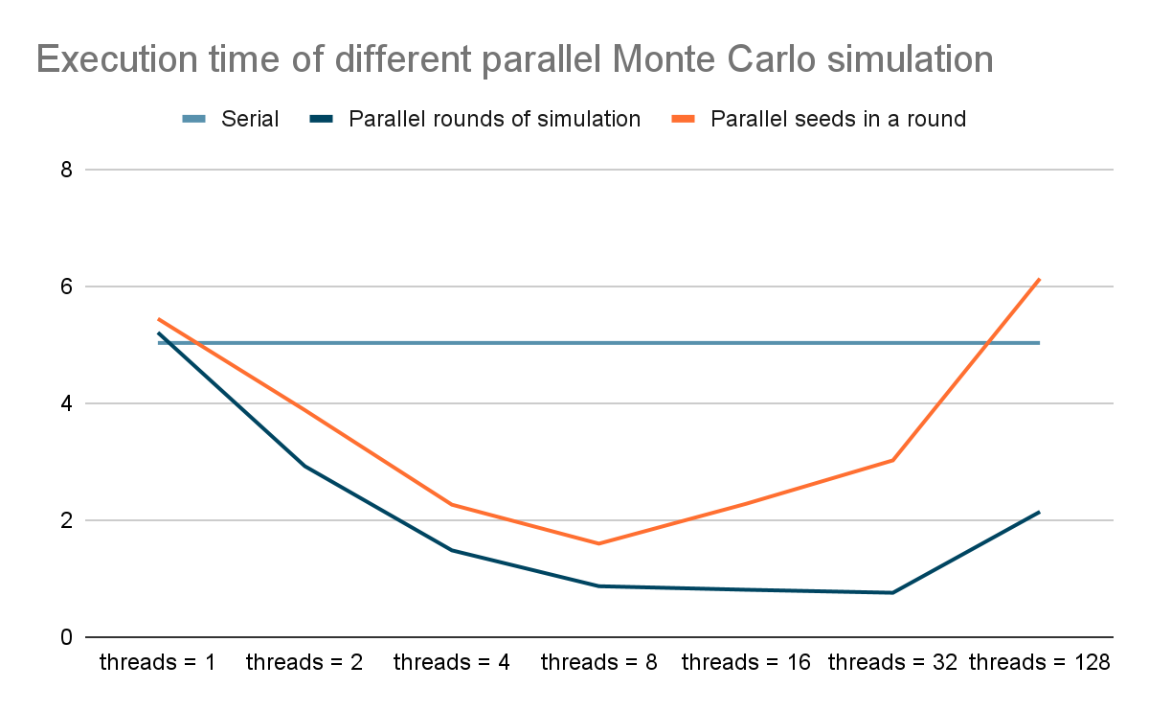
Results
Parallel Monte Carlo simulation does not decrease the spread result because there is no data contention nor outdated data in the parallel code.
The speedup results are close to T (threads) times faster before threads = 8.
Time increased again when threads > 8 because the more threads are generated, the more overheads it contains.

Slide 11
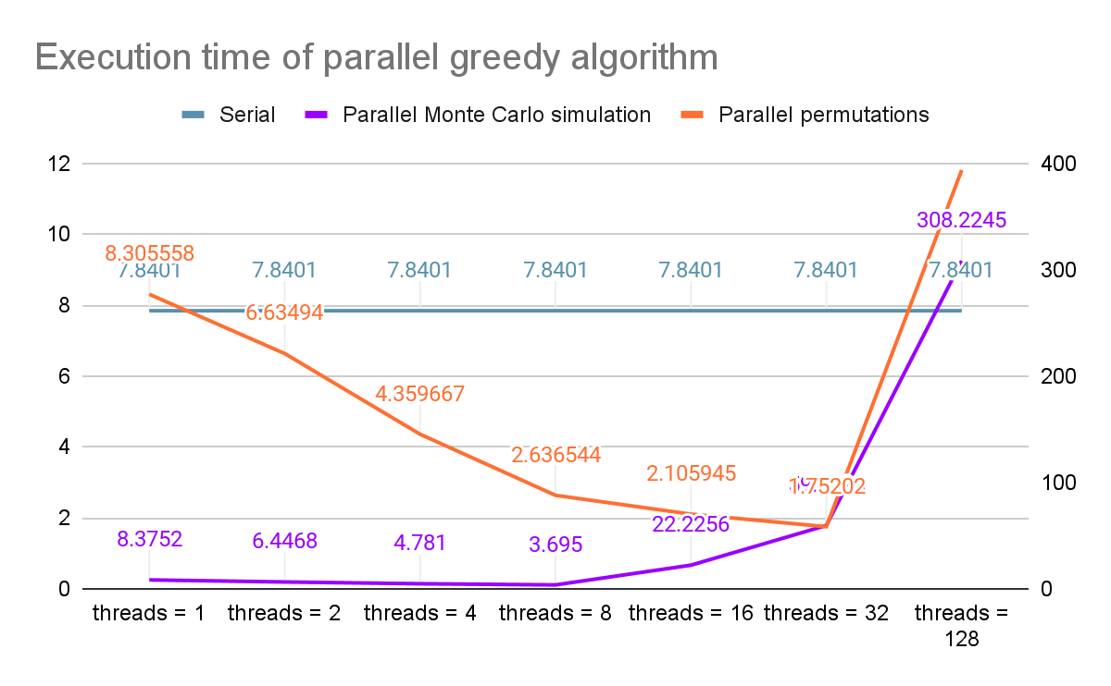
Results
On greedy algorithm, Parallelizing the computation of each permutation is better and can give best speedup when number of threads = 32.
The OpenMP overhead results in the bad speedup of parallelizing Monte Carlo Simulation.
The speedup limitation mainly lies in the OpenMP overhead.

Slide 12
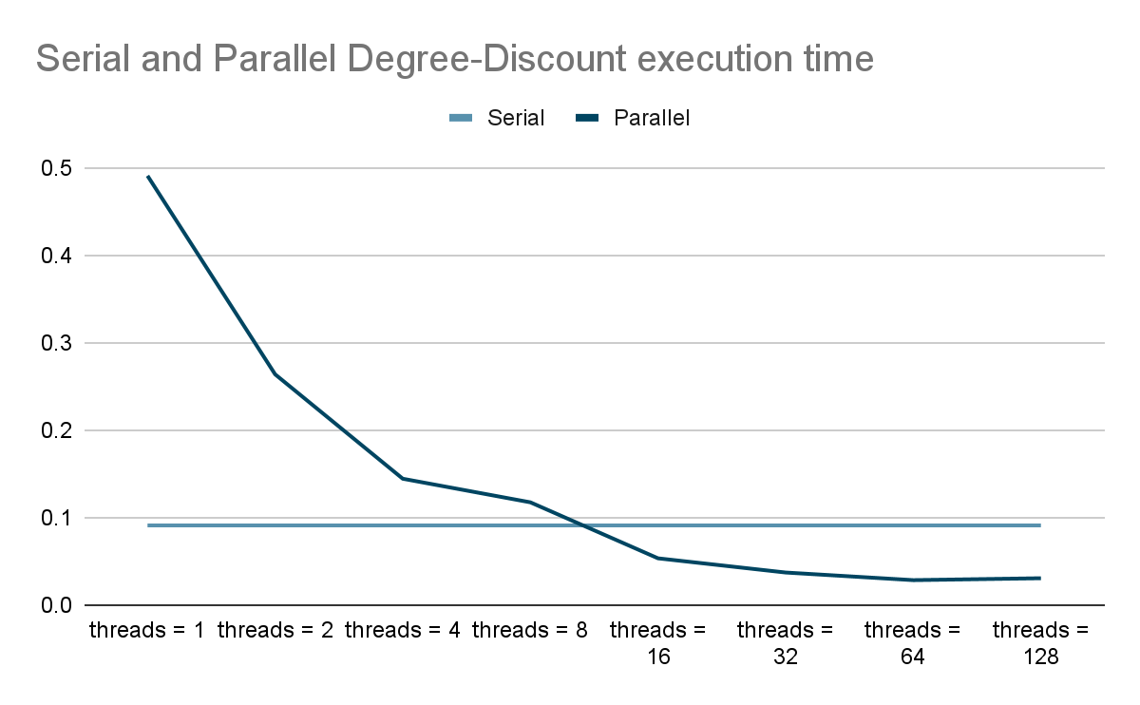
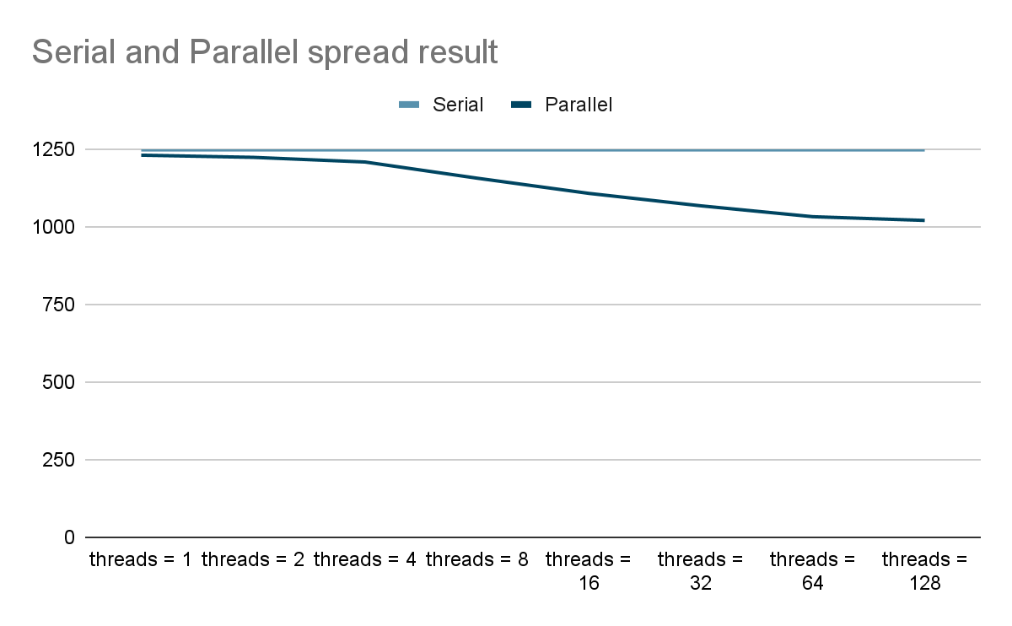
Results
Parallel Degree-Discount heuristic will run faster than sequential when number of threads >= 16.
The propagation result will drop as the number of threads increases due to tradeoff.
The speedup limitation mainly lies in locks.

Slide 13
Results
Milestone
Successfully used OpenMP to parallelize the sequential influence spread algorithm in 3 different domains and 5 dimensions, and built a user-defined tool to generate arbitrary kind of dataset.
Tested the parallel algorithms on different datasets to ensure the performance speedup could scale.
Verify a drop in speedup when nThreads is very high due to extra work as well as the approach which will not drop the influence results.
Produced a comprehensive multidimensional scaling report that analyzed the features of our influence maximization algorithms.
Goal
We reached both the 100% basic goals and 125% stretch goals.

Slide 14
Thank You

